Slide 1



RESUME PROJECT CHALLENGE-4
PROVIDING ACTIONABLE INSIGHTS TO MANAGEMENT IN THE CONSUMER GOODS DOMAIN
by
Manohar Teja

Slide 2
INTRODUCTION
Atliq Hardwares, a leading computer hardware manufacturer, aims to enhance data-driven decision-making. To bridge the insights gap, they plan to expand their analytics team.
Tony Sharma, the Data Analytics Director, seeks candidates with strong tech and soft skills. To evaluate them, he designed an SQL challenge to assess analytical and problem-solving abilities.

Slide 3
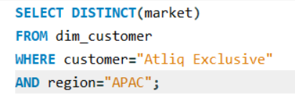
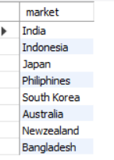
Request 1
Provide the list of markets in which customer "Atliq Exclusive" operates its business in the APAC region.
Query
Result

Slide 4
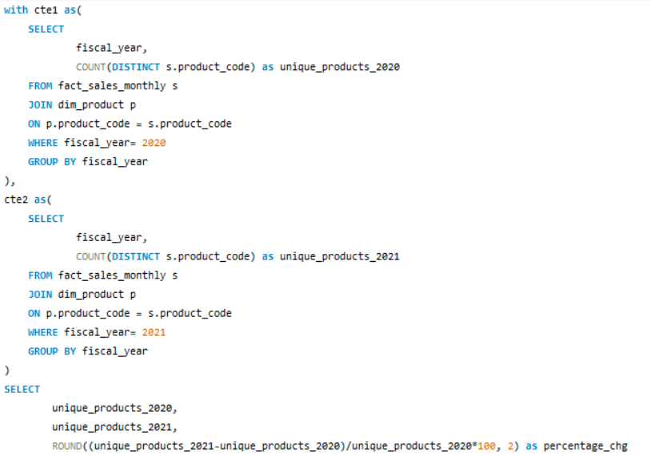

Request 2
What is the percentage of unique product increase in 2021 vs.2020?
Query
Result
The company had more unique products in 2021 than in 2020.
i.e., 36.33%

Slide 5
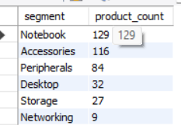
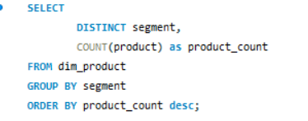
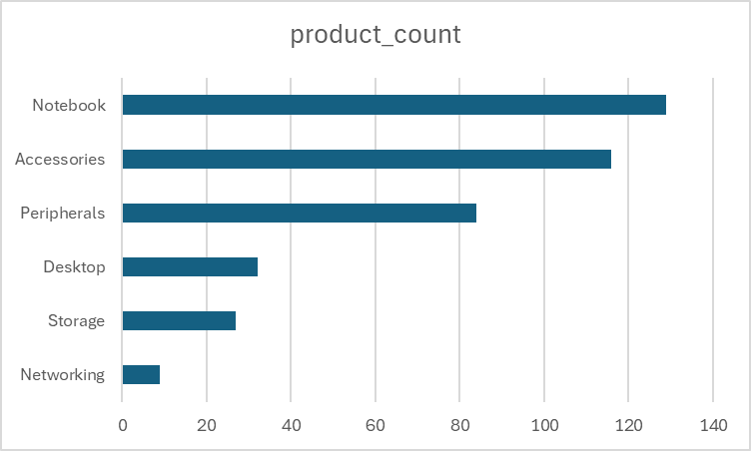
Request 3
Provide a report with all the unique product counts for each segment and sort them in descending order of product counts
Notebooks, Accessories and Peripherals contribute to 83% of the total Unique Product Count.

Slide 6
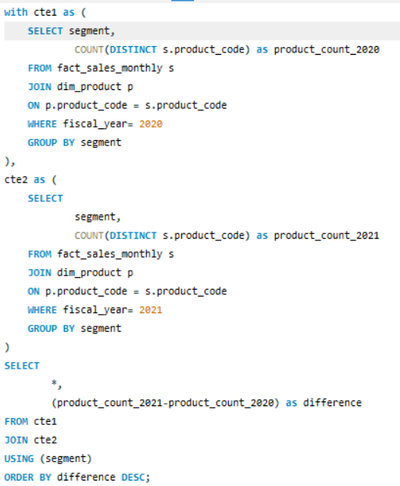
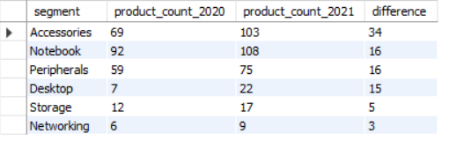
Request 4
Follow-up: Which segment had the most increase in unique products in 2021 vs 2020?
Accessories, Notebook and Peripherals
had the most increase in unique product

Slide 7
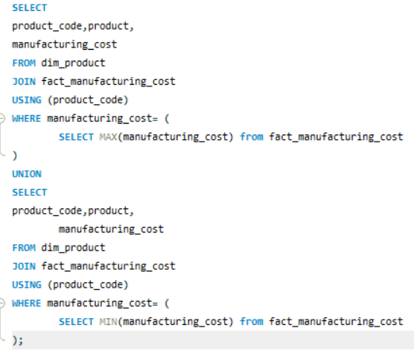

Request 5
Get the products that have the highest and lowest manufacturing costs. The final output should contain these fields, product_code, product, manufacturing_cost

Slide 8
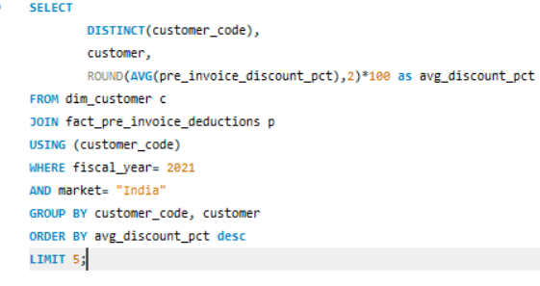
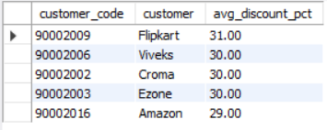
Request 6
Generate a report which contains the top 5 customers who received an average high pre_invoice_discount_pct for the fiscal year 2021 and in the Indian market. The final output contains these fields, customer_code customer average_discount_percentage

Slide 9
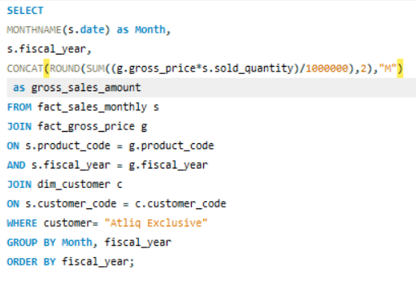
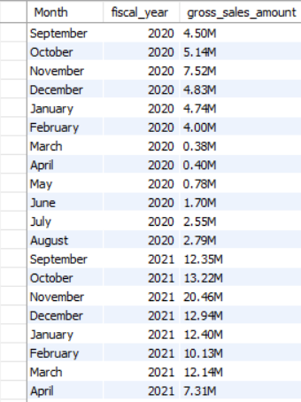
Request 7
Get the complete report of the Gross sales amount for the customer “Atliq Exclusive” for each month . This analysis helps to get an idea of low and high-performing months and take strategic decisions. The final report contains these columns: Month Year Gross sales Amount

Slide 10

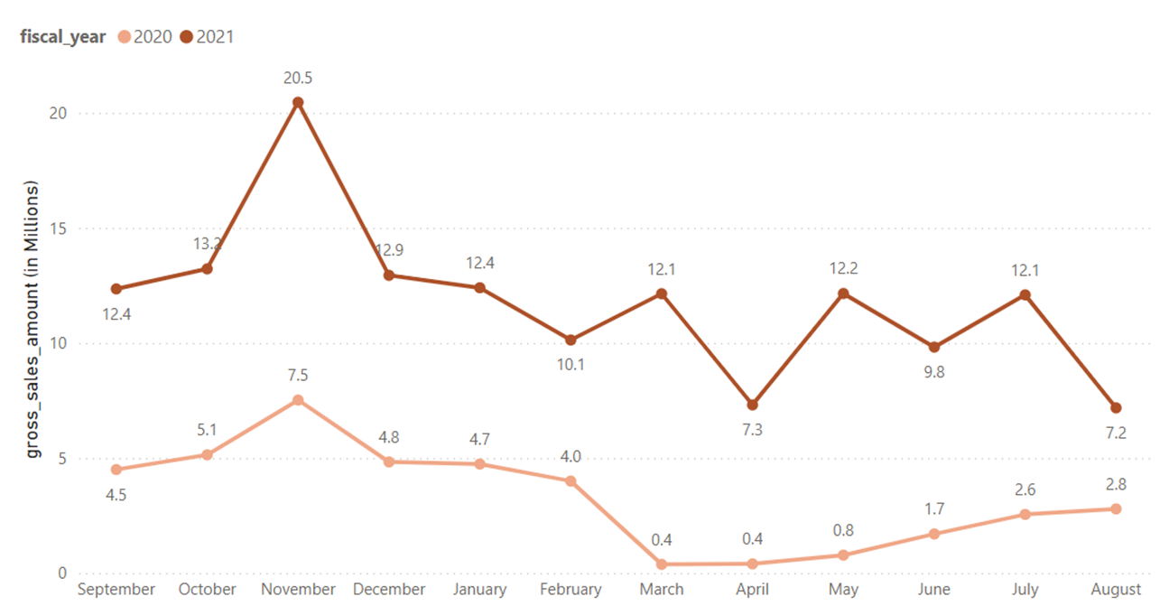
The sudden drop in gross sales amount in March FY 2020 (from $4 Million to $0.4 Million ) was due to the start of the pandemic period of COVID-19 virus. After that, we can see a gradual increase as the market were starting to open and gaining more sales.

Slide 11
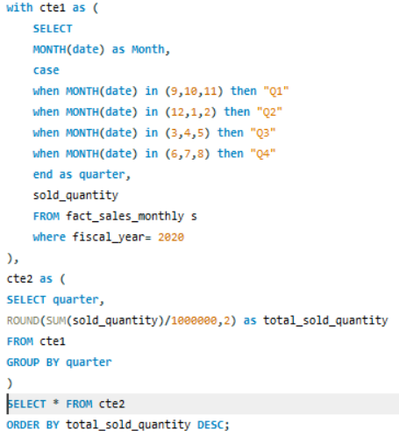
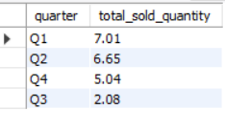
Request 8
In which quarter of 2020, got the maximum total_sold_quantity? The final output contains these fields sorted by the total_sold_quantity, Quarter,total_sold_quantity
Quarter 1 was the one with the highest total sold quantities(in millions) of products in 2020.
Sudden drop in Quarter 3 of 2020 because of the lower manufacturing growth due to COVID-19 pandemic. No consumers, No growth!

Slide 12
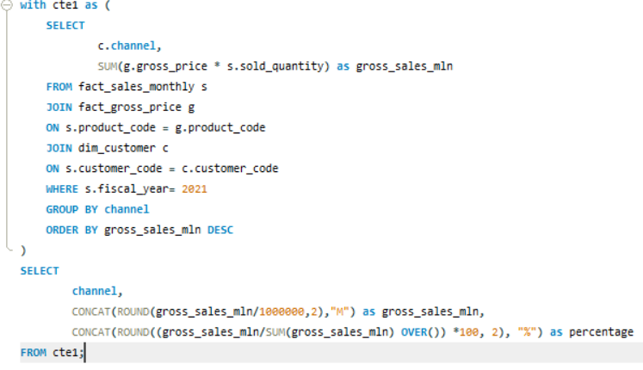

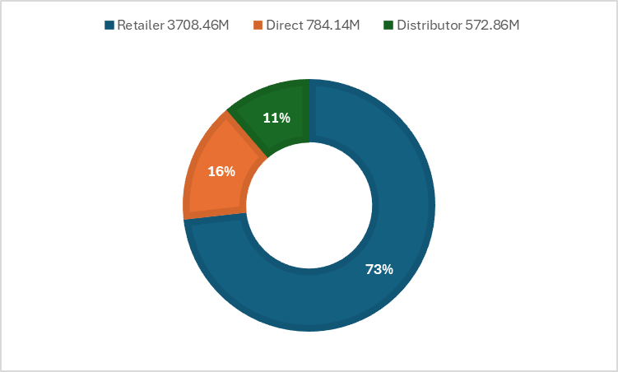
Request 9
Which channel helped to bring more gross sales in the fiscal year 2021 and the percentage of contribution? The final output contains these fields, channel ,gross_sales_mln,percentage

Slide 13
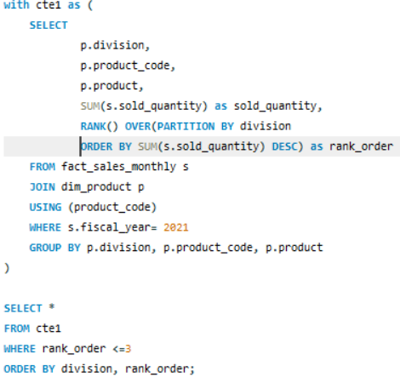
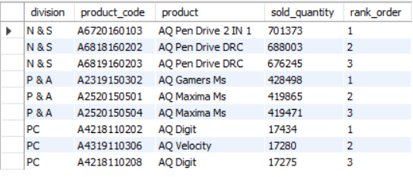
Request 10
Get the Top 3 products in each division that have a high total_sold_quantity in the fiscal_year 2021? The final output contains these fields division product_code, product, total_sold_quantity, rank_order

Slide 14
THANK YOU

